Slide 1
TINTIN: Thrust-Integrated Neural Touchdown with Reinforcement Learning and INertial Navigation

Slide 2
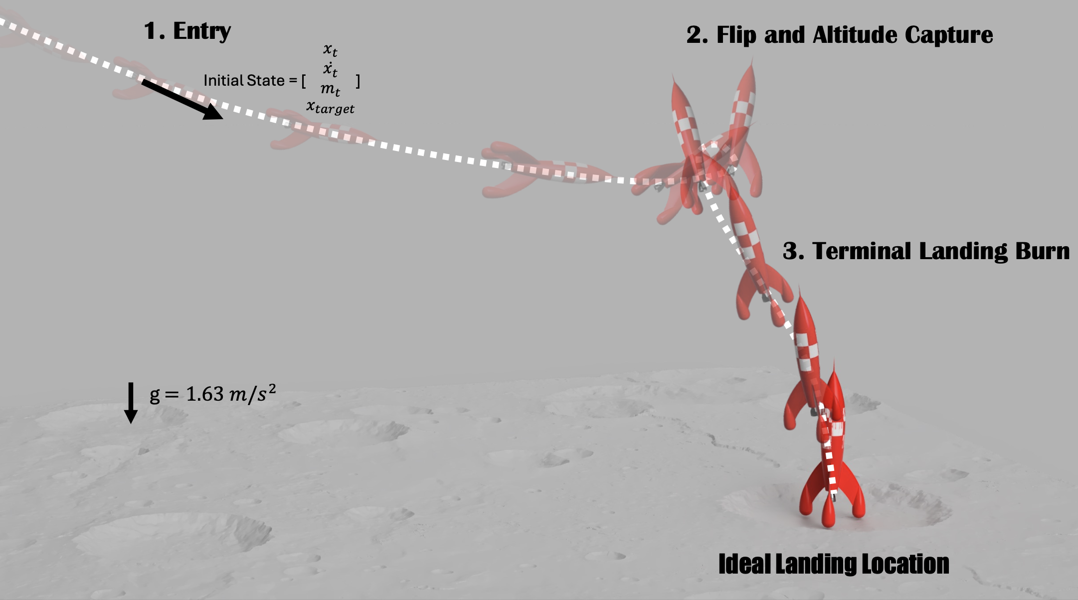
Notes:
Motivations: Childhood inspiration
Economic cost down – space X success yesterday
Use RL – modern control spin

Slide 3
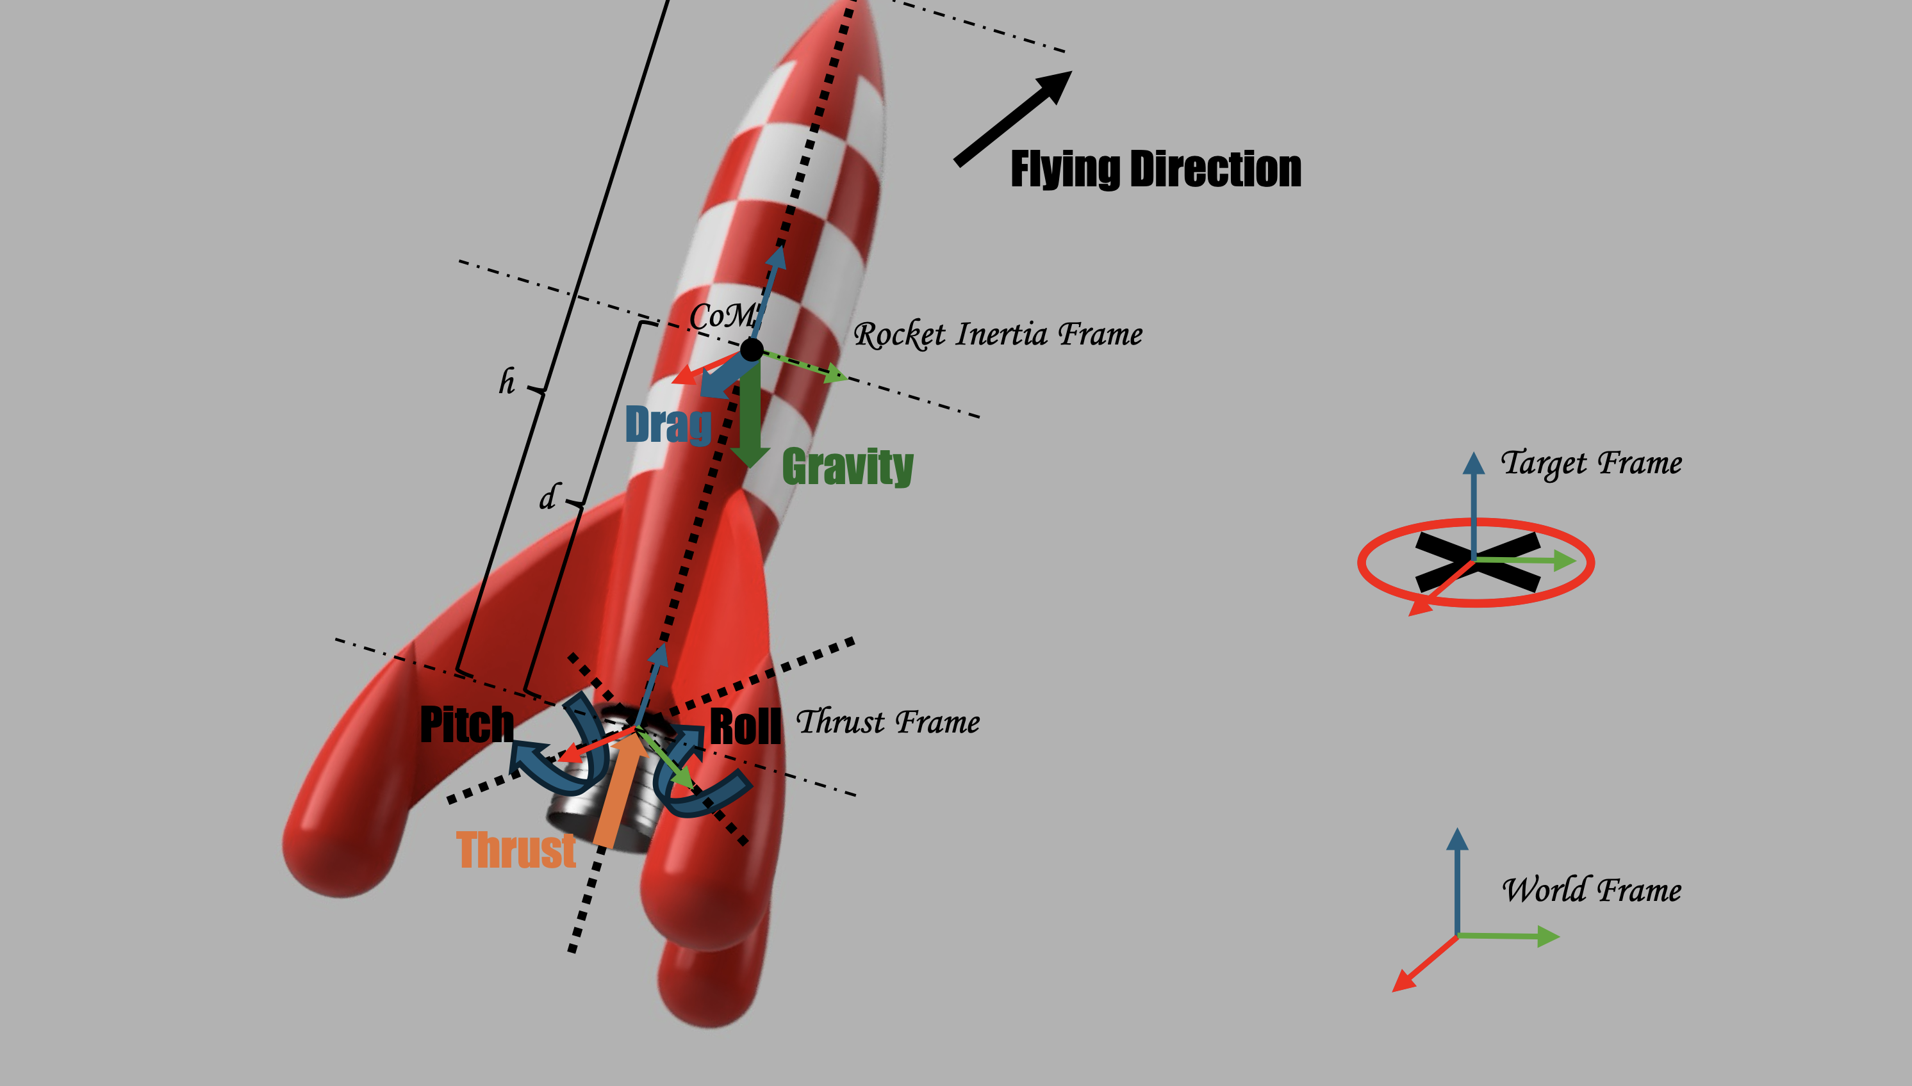
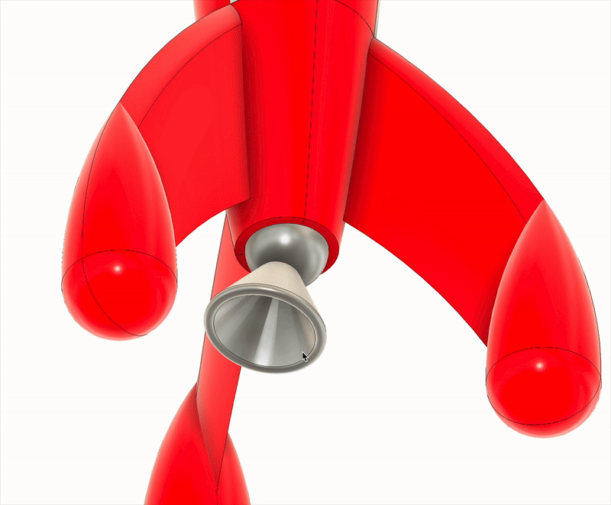
Notes:
Here
Related work – novelty – point mass – lack of physics simulation from the RL side

Slide 4
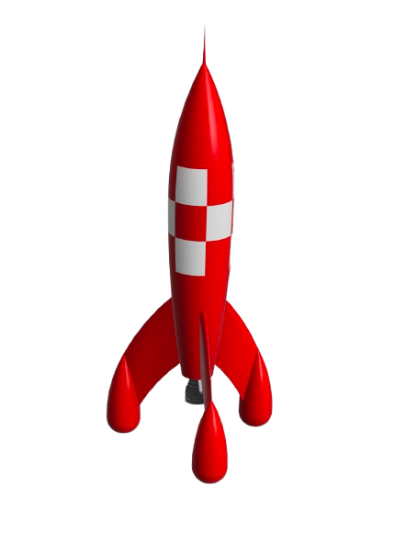
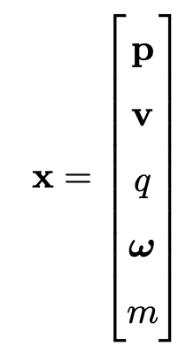
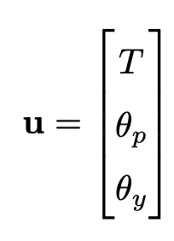
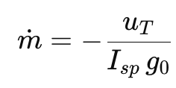
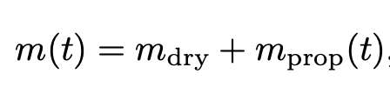
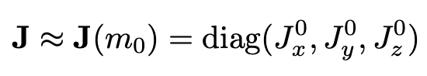
Analytical Modeling
Assumptions:
No air resistance
Body CoM stays fixed
Body inertia stays the same
Mass consumption is linear to magnitude of thrust
State:
Action:
Variable Mass:
Fixed Inertia:

Slide 5
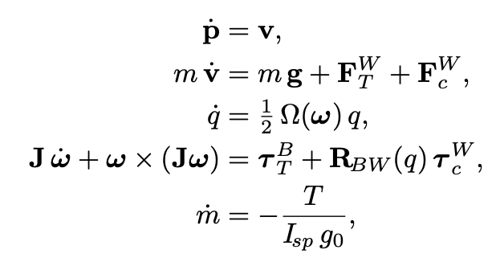
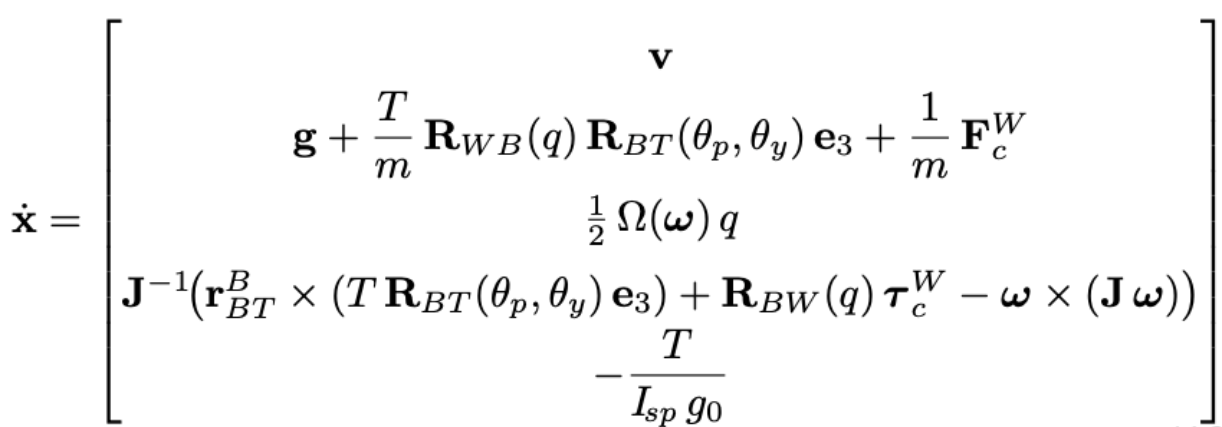
Analytical Modeling
Dynamics Equations:
Robot Nonlinear Dynamics:

Slide 6
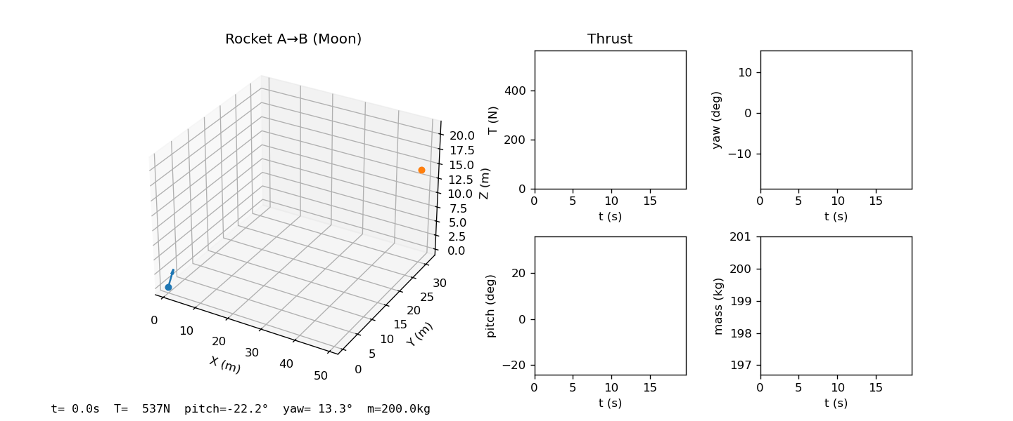
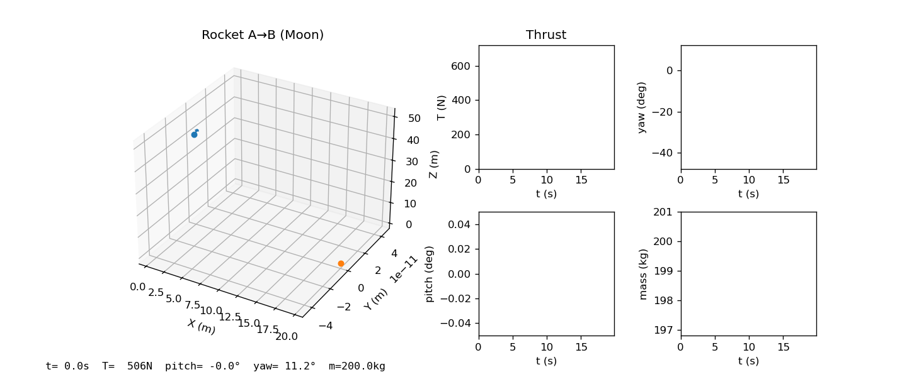
Analytical Testing

Slide 7
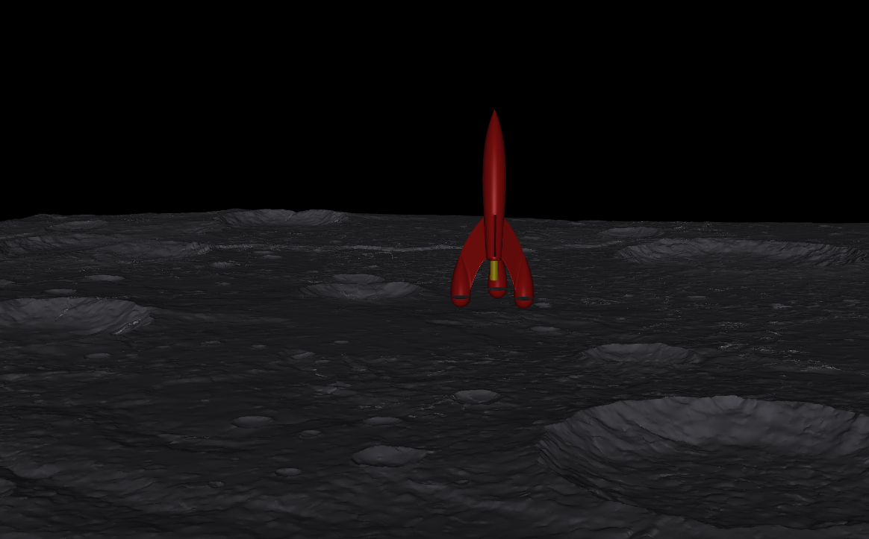
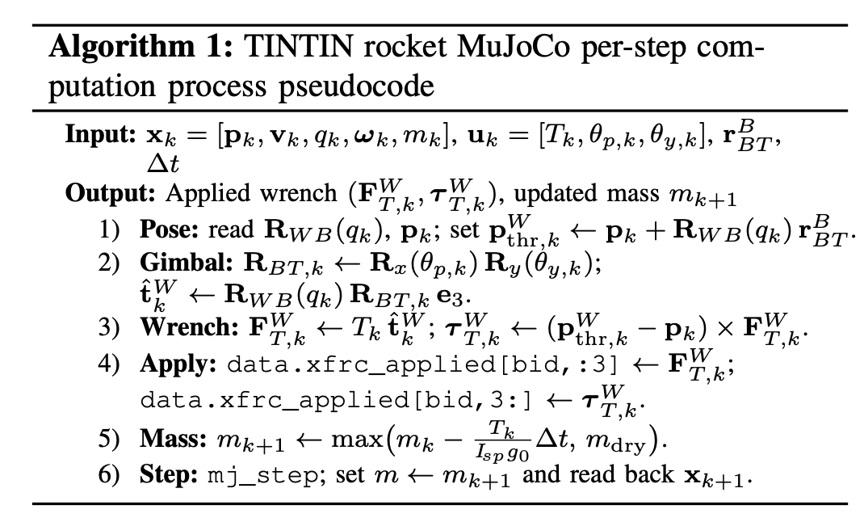
MuJoCo Modeling
Notes:
Mujoco modeling – API

Slide 8
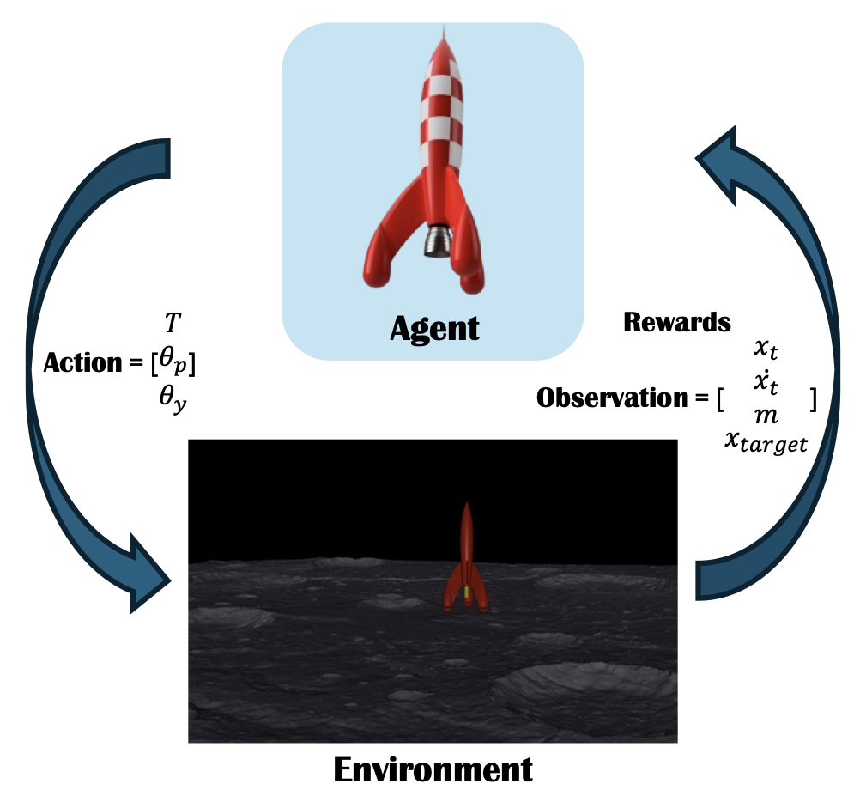
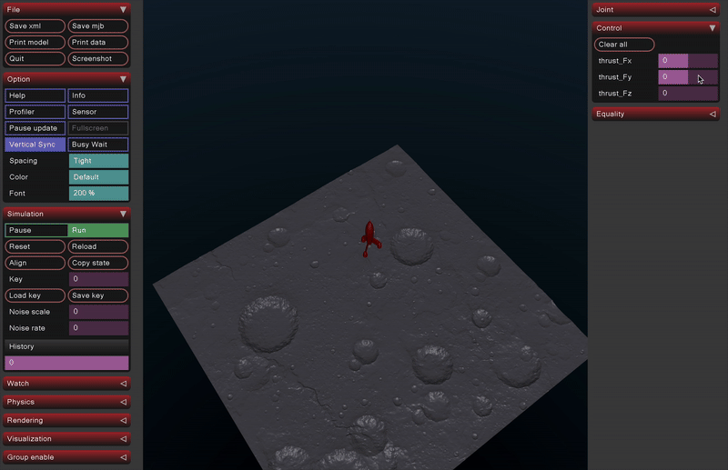
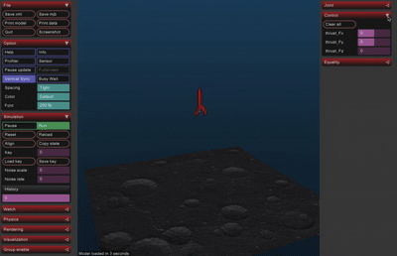
MuJoCo Modeling

Slide 9
Thank you!

